Slide 1

CV Website Project Proposal
Let’s begin our project

Slide 2
The Website Properties
This is a small Table to describe some properties
Fonts | I used many fonts like font awesome and others..
Used and alternative resources | With this project i used CSS JS AND HTML
Colors | I Used as colors Green and gray. Nice combination no?
Icons and infographic resources | I used my photos like Certifies….
Editable presentation theme | You can edit the master slides easily. For more info, click here

Slide 3
Table of contents
01
04
02
05
03
06
Objectives
Solutions
Resources
Communication plan
Budget
Conclusion

Slide 4
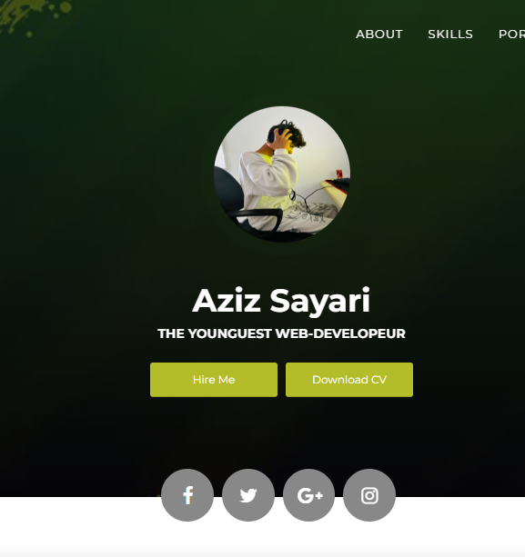

A little description for my website
Through a dynamic CV website, I showcased my newly acquired skills in HTML, CSS, and JavaScript, offering an interactive display of my evolving capabilities and experiences.

Slide 5
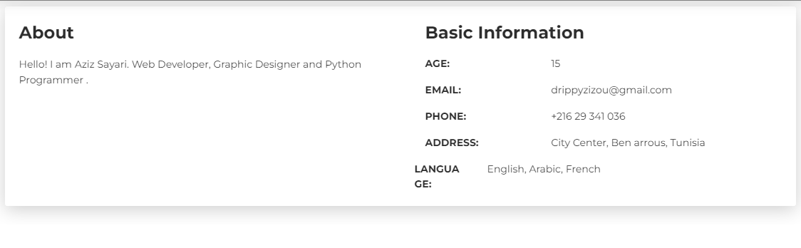
Home page
01

Slide 6
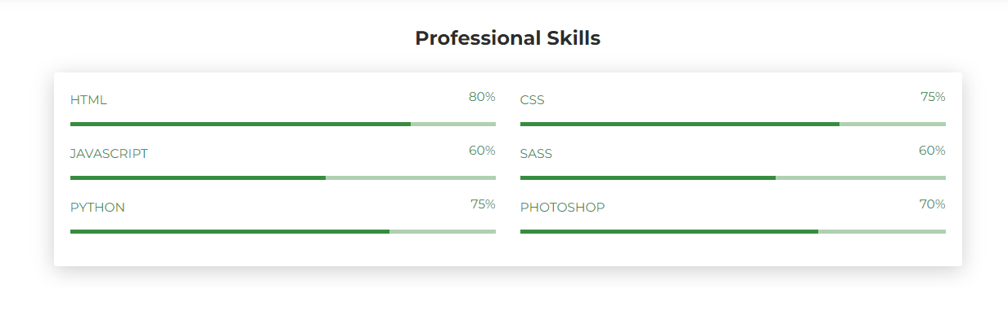
skills page
02

Slide 7
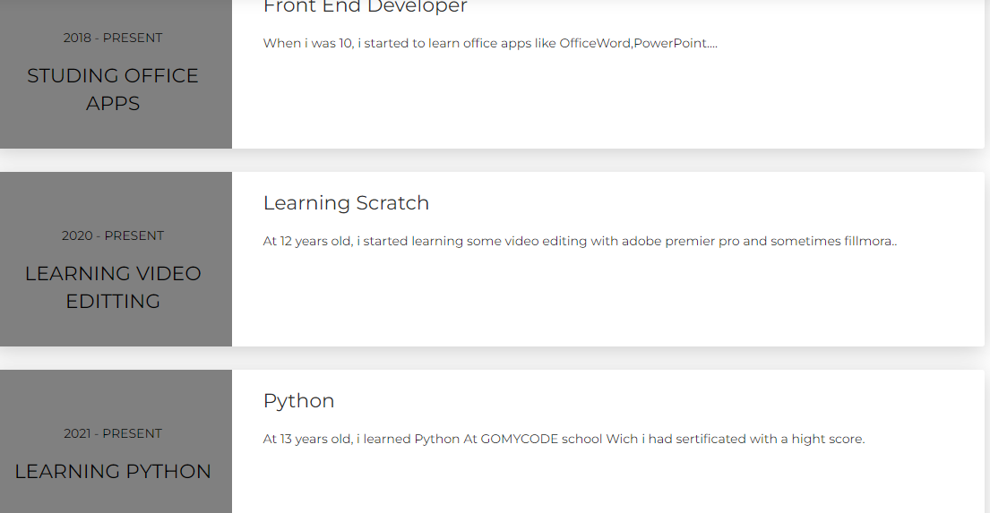
Experience page
03

Slide 8
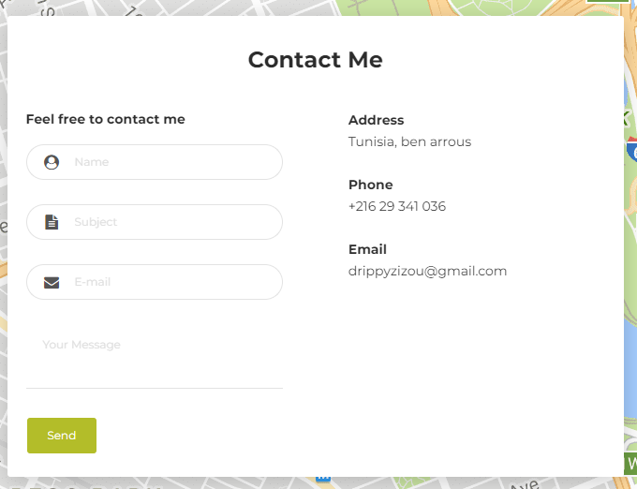
Contact page
04

